Slide 1
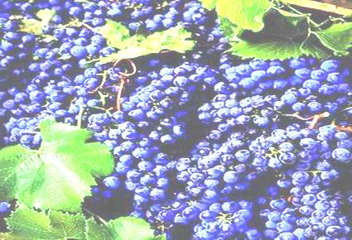
Downy & powdery mildew control strategy in vineyard
R.Bugiani

Slide 2
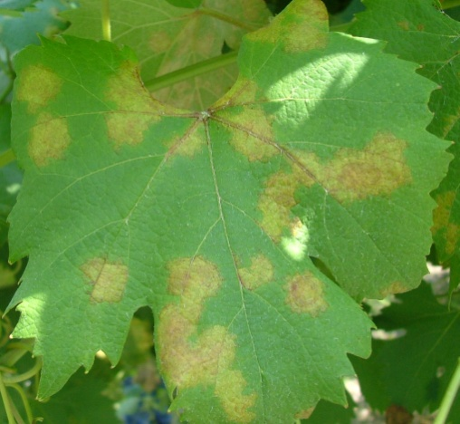
Choice of fungicide for downy mildew
Infection Risk
Areas more conducive for the disease
Cv susceptibility
Phenological Phase (canopy growing rate, berry susceptibility)
Rainy infectious events

Slide 3
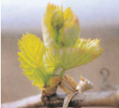
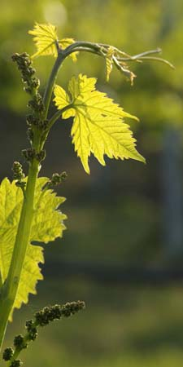
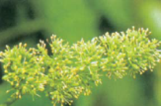
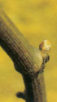
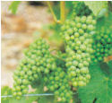
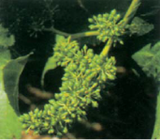
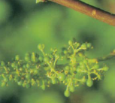
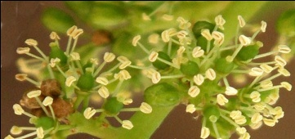
Downy mildew: infection risk in the growing the season
Shoots
3-5 cm
small bunches
Small bunches
Pre-bloom
Swollen buds
Bunch closure
Berry set
Pre-bloom
Maturation
veraison
Berry growing

Slide 4
Shoot 3-5 cm– bunches visibles
Start to spray following warning of forecasting model
Preventative sprays
Disease pressure
low
High
copper
metiram
propineb
traslaminars:
dimetomorf+Contact
benthiavalicarb+copper
mandipropamide+copper
or in mixtture with systemic:
fosetyl-al
K-phosphonate

Slide 5
Da grappolini visibili a prefioritura
Vegetazione in elevato accrescimento e grappolini molto suscettibili
Rischio fitosanitario
Alto
sistemici:
benalaxyl+rame
metalaxyl-m+rame
metalaxyl+rame
traslaminari:
dimetomorf+contatto
benthiavalicarb+rame
mandipropamide+rame
in miscela con:
sali di rame
metiram
propineb
fosetyl-al
fosfonato dipotassio

Slide 6
pre-bloom to berry set
Canopy growing and susceptible bunches
High disease pressure
Formulations with 2-3 mode of action
systemic:
benalaxyl+copper
metalaxyl-m+copper
metalaxyl+copper
fosetyl-al
K-phosphonate
Traslaminars:
benthiavalicarb+copper dimetomorf+copper
dimetomorf+metiram
iprovalicarb+copper
mandipropamide+copper
fluopicolide +propineb
fluopicolide +fosetyl-al
cymoxanil+fosetyl-Al/zoxamide
contact:
ametoctradin
ametoctradin+metiram
ciazofamide
fenamidone+fosetyil-Al
fenamidone+fosetyil-Al+ iprovalicarb
zoxamide

Slide 7
From berry growing to bunch closure
Bunches still susceptible
High disease pressure
Formulation with wax affinity
contact
ametoctradin
ametoctradin+metiram
ciazofamide
zoxamide+rame
traslaminar:
fluopicolide +propineb
fosetyl-al
K-phosphonate

Slide 8
From veraison to maturation
Protection of new canopy
Low disease pressure
Infected plots
contact:
Copper
Sistemics to protect new shoots:
fosetyl-Al
K-phosphonate

Slide 9
Active features
For downy mildew
A.I. | Chemical group | Efficacy on leaf | Efficacy on bunches | Mobility in the plant | Risk of resistance | Limitation n°appl./season
Cu++ oxychloride | inorganic | + | ++ | Contact | Low
Cu++ hydroxide | Inorganic | + | ++ | Contact | Low
Bordeaux mixture | Inorganic | + | ++ | Contact | Low
Cu++ oxyde | Inorganic | + | ++ | Contact | Low
metiram | Dithiocarbammates | ++ | ++ | Contact | low | After bloom max 2 sprays
propineb | Dithiocarbammates | ++ | ++ | Contact | low

Slide 10
Active features
For downy mildew
A.I. | Chemical group | Efficacy on leaf | Efficacy on bunches | Mobility in the plant | Risk of resistance | Limitation n°appl./season
benthiavalicarb + rame | CAA inorganici | ++(+) | ++(+) | Translaminare | Basso-Medio | Max 3 | Max 4
dimetomorph + rame | CAA inorganici | ++(+) | ++(+) | Translaminare | Basso-Medio
dimetomorph + metiram | CAA Ditiocarbammati | ++(+) | ++(+) | Translaminare | Basso-Medio
iprovalicarb + rame | CAA Inorganici | ++(+) | +(+) | Translaminare | Basso-Medio
mandipropamide + rame | CAA Inorganici | ++(+) | +++ | Translaminare | Basso-Medio
cymoxanil | ossimo di ciano acetamide | + | 0 | Translaminare | Basso-Medio | Max 3
benalaxyl + rame | fenilammidi Inorganici | ++(+) | +(+) | Sistemico | Alto | Max 3
metalaxyl + rame | fenilammidi Inorganici | +++ | ++ | Sistemico | Alto
metalaxyl-m + rame | fenilammidi Inorganici | +++ | ++ | Sistemico | Alto
fosetil-Al | fosfonati | +(+) | 0 | Sistemico | Basso
fosfonato di potassio | fosfonati | +(+) | 0 | Sistemico | Basso | Max 5

Slide 11
Tab. Caratteristiche delle sostanze attive
per peronospora
A.I. | Chemical group | Efficacy on leaf | Efficacy on bunches | Mobility in the plant | Risk of resistance | Limitation n°appl./season
ciazofamid | QII | ++(+) | +++ | Contatto | Medio-Alto | Max 3
ametoctradina | QoSI | +(+) | ++(+) | Contatto | Medio - Alto | Max 3
ametoctradina+ metiram | QoSI | ++(+) | +++ | Contatto | Medio - Alto
fluopicolide + fosetil-Al | benzamidi fosfonati | +++ | ++(+) | Translaminare Sistemico | Sconosciuta-- | Max 3
fluopicolide + propineb | benzamidi ditio carbannati | ++(+) | +++ | Translaminare Contatto | Sconosciuta
zoxamide | benzamidi | +(+) | + +(+) | Contatto | Basso-Medio | Max 4
fenamidone + fosetil-Al | QoI fosfonati | ++ | +(+) | Contatto Sistemico | Alto | Max 3
fenamidone + fosetil-Al + iprovalicarb | QoI Fosfonati CAA | ++ (+) | ++ | Contatto Sistemico Translaminare | Alto

Slide 12
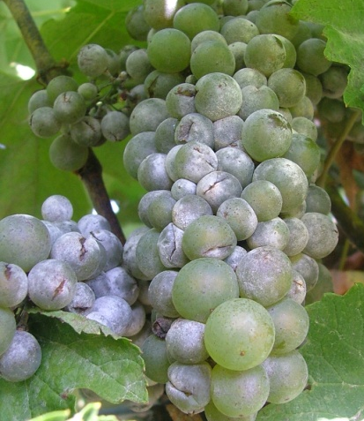
Choice of fungicide for powdery mildew
Infection Risk
Growing areas with favourable conditions for infection (Hillside, plain)
Cv susceptibility (i.e. Pinot & Chardonnay more susceptible)
Severity of the disease in the previous year
Plant Phenology (canopy growing, berry susceptibility)
Rainy event during primary season

Slide 13
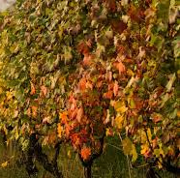
PM: disease pressure during the season
Pre-Fioritura
Gemma cotonosa
Germogli
3-5 cm
Grappolini visibili
Grappolini visibili
Pre-Fioritura
Allegagione
Accrescimento
Post-raccolta
Maturazione
Pre-raccolta
Invaiatura
Pre chiusura
grappolo

Slide 14
Swollen bud
Low disease pressure
Vineyard severily affected the previous year
sulphur

Slide 15
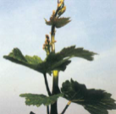
From bud break to visible bunches
Sprays directed on ascospore infection rainy events
Disease pressure
Low: plain, in most of the vineyard
High: in hillside, in particular in vineyard severily affected the previous year
bupirimate
meptil-dinocap
spiroxamine
sulphur

Slide 16
From visible bunches to pre-bloom
Canopy actively growing
Disease pressure
High
bupirimate
spiroxamine
sulphur
difenconazole
miclobutanil
penconazole
propiconazole
tebuconazole
tetraconazole

Slide 17
From pre-bloom to berry growing
Susceptible shoots and from berry set susceptible bunches
Disease pressure
High
sulphur
K-carbonate
difenconazole
miclobutanil
penconazole
cyflufenamid
cyflufenamid+difenconazole
metrafenone
quinoxifen+miclobutanil
trifloxystrobin+sulphur
trifloxystrobin+tebuconazole
propiconazole
tebuconazole
tetraconazole

Slide 18
From pre-bunch closure to veraison
Protection of bunches
Disease pressuer
Alto
low
Wettable sulphur
Dust sulphur
boscalid
cyflufenamid
metrafenone
quinoxifen+miclobutanil

Slide 19
From maturation to pre-harvest
Low disease pressure
sulphur
K-carbonate
Post-harvest
Ampelomyces quisqualis

Slide 20
Active features
For powdery mildew
Sostanze attive | Famiglia chimica | Efficacia su foglia | Efficacia su grappolo | Mobilità nella pianta | Rischio resistenza | Limitazioni n. appl./anno
zolfo | inorganico | + | +(+) | Contatto | Basso
bicarbonato di potassio | inorganico | ++ | ++ | Contatto | Sconosciuto
Ampelomyces quisqualis | microrganismo | -- | -- |  | sconosciuto
bupirimate | aminopirimidine | +(+) | +(+) | Traslaminare | Medio
bupirimate + tebuconolo | aminopirimidine triazoli | ++ | ++(+) | Traslaminare Sistemico | Medio | Max 3 limite triazoli
meptyldinocap | dinitrofenoli | ++ | ++ | Contatto | Basso - Medio | Max 2
metrafenone | benzofenoni | ++ | +++ | Traslaminare | Medio | Max 3
cyflufenamid | fenil-acetamide | ++ | +++ | Traslaminare | Alto | Max 3
cyflufenamid + difenconazolo | fenil-acetamide + triazoli | ++(+) | +++ | Traslaminare Sistemico | Alto
quinoxifen | fenossichinoline | +(+) | ++ | Contatto | Medio | Max 3
quinoxifen + miclobutanil | fenossichinoline + triazoli | ++(+) | +++ | Contatto Sistemico | Medio
spiroxamina | sproketalamine | ++ | ++(+) | Sistemico | Basso - Medio | Max 3

Slide 21
Tab. Caratteristiche delle sostanze attive
per oidio
Sostanze attive | Famiglia chimica | Efficacia su foglia | Efficacia su grappolo | Mobilità nella pianta | Rischio resistenza | Limitazioni n. appl./anno
trifloxystrobin | QoI | +(+) | ++(+) | Traslaminare | Alto | Max 3
tebuconazolo + trifloxystrobin | triazoli QoI | ++ | +++ | Sistemico | Alto
ciproconazolo | triazoli | ++ | +(+) | Sistemico | Alto | Max 3
difenconazolo | triazoli | ++ | +(+) | Sistemico | Alto
fenbuconazolo | triazoli | ++ | +(+) | Sistemico | Alto
miclobutanil | triazoli | ++ | +(+) | Sistemico | Alto
penconazolo | triazoli | ++ | +(+) | Sistemico | Alto
propiconazolo | triazoli | ++ | +(+) | Sistemico | Alto
tebuconazolo | triazoli | ++ | +(+) | Sistemico | Alto
tetraconazolo | triazoli | ++ | +(+) | Sistemico | Alto
boscalid | piridine -carbossamidi | +(+) | +++ | Traslaminare | Medio - Alto | Max 1

Slide 22
Strategia antiresistenza
Attenersi al numero massimo di interventi consentiti all’anno per una determinata sostanza attiva
Alternare sostanze attive appartenenti a famiglie chimiche diverse
Usare miscele con sostanze attive a diverso meccanismo d’azione
Usare i prodotti a dose piena e mai sotto-dosati

